Slide 1
1D full wave simulation in magnetized plasma(cold)
Xinhang Xu
9/2/2024

Slide 2
Overview
Motivation
Update from Frequency region to Time region
Numerical Method
Numerical Test
USPR simulation
Next Steps

Slide 3
Motivation
1. Analysis of Mode Conversion in Magnetized Plasma(x to O)
2. Numerical Simulation for Plasma Diagnostics
3. More Efficient and Accessible Compared to 3D FDTD Simulation in Magnetically Confined Plasma

Slide 4
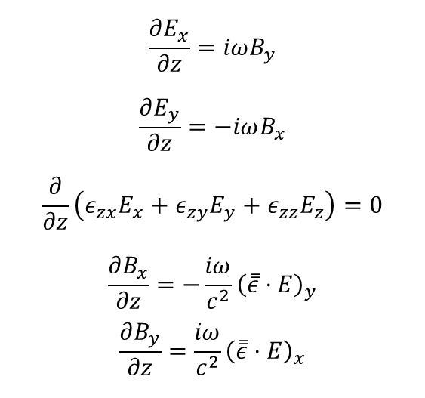
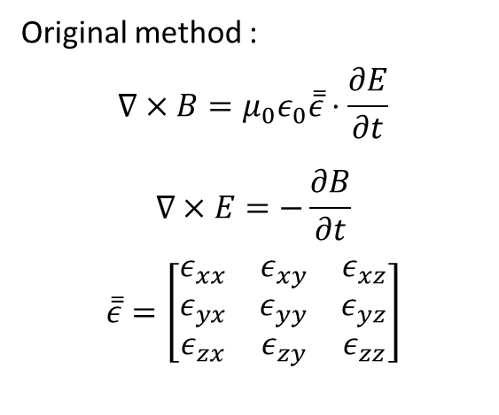
Update from Frequency region to Time region
Original method :
$$∇×B=μ_{0}ε_{0}\overset{̿}{ε}⋅\frac{∂E}{∂t}$$
$$∇×E=−\frac{∂B}{∂t}$$
$$\overset{̿}{ε}=\left[\begin{matrix}ε_{xx} & ε_{xy} & ε_{xz} \\ ε_{yx} & ε_{yy} & ε_{yz} \\ ε_{zx} & ε_{zy} & ε_{zz}\end{matrix}\right]$$
$$\frac{∂E_{x}}{∂z}=iωB_{y}$$
$$\frac{∂E_{y}}{∂z}=−iωB_{x}$$
$$\frac{∂}{∂z}\left(ε_{zx}E_{x}+ε_{zy}E_{y}+ε_{zz}E_{z}\right)=0$$
$$\frac{∂B_{x}}{∂z}=−\frac{iω}{c^{2}}{\left(\overset{̿}{ε}⋅E\right)}_{y}$$
$$\frac{∂B_{y}}{∂z}=\frac{iω}{c^{2}}{\left(\overset{̿}{ε}⋅E\right)}_{x}$$
Fourier Transformer
Advantages:
Quick mode conversion analysis
Easy to write code
Disadvantages:
Limited to a single frequency during simulation
Cannot be applied to many diagnostic analyses, such as DBS and USPR
Difficult to analyze reflected signals from the cutoff layer
Lacks time resolution

Slide 5
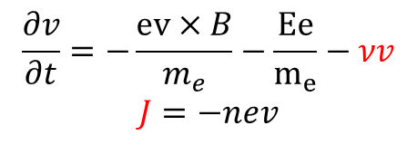

Upgrade method :
Background: Magnetically plasma without plasma current
$$∇×E=−μ_{0}\frac{∂H}{∂t}$$
$$∇×H=ε_{0}\frac{∂E}{∂t}+J$$
$$\frac{∂J}{∂t}=ω_{ce}×J+ε_{o}ω_{pe}^{2}E−νJ$$
Plasma density
$$\frac{∂v}{∂t}=−\frac{ev×B}{m_{e}}−\frac{Ee}{m_{e}}−νv$$
$$J=−nev$$
E field of EMW
Electron velocity equation
Tokamak Magnetic Field
Current induced by EMW
electron-electron collision frequency
Advantage :
1. Capable of time evolution analysis
2. Closer to real physics problem compared with Frequency region method.
3. Can numerically simulate diagnostic physics, such as USPR and DBS

Slide 6
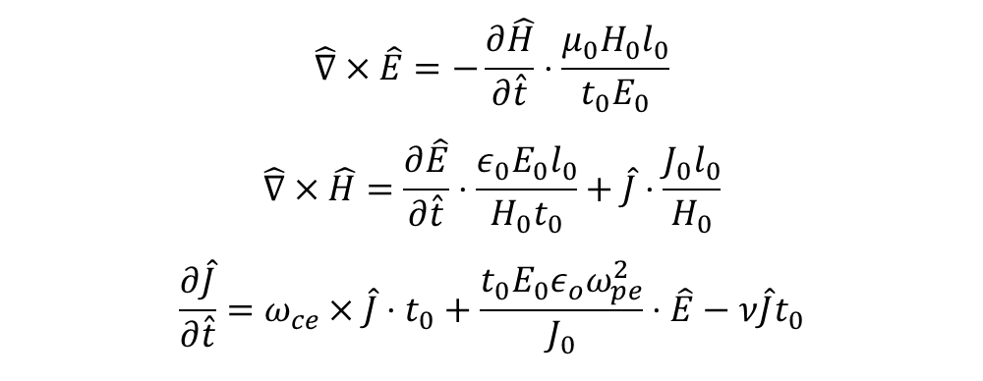
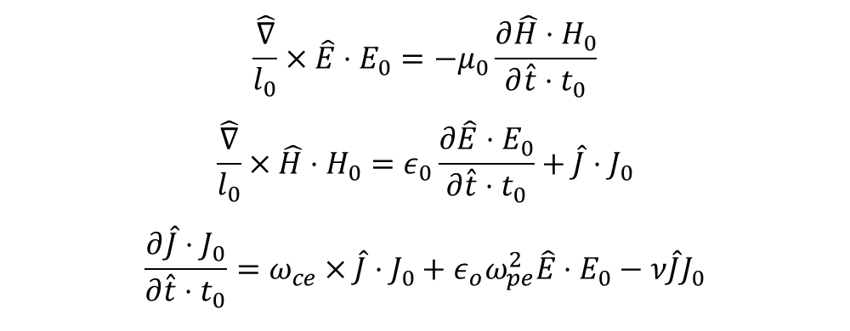
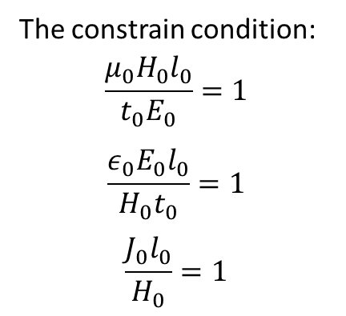
Numerical Method:
1. dimensionless equations by normalizing with characteristic parameters:
$$\frac{\hat{∇}}{l_{0}}×\hat{E}⋅E_{0}=−μ_{0}\frac{∂\hat{H}⋅H_{0}}{∂\hat{t}⋅t_{0}}$$
$$\frac{\hat{∇}}{l_{0}}×\hat{H}⋅H_{0}=ε_{0}\frac{∂\hat{E}⋅E_{0}}{∂\hat{t}⋅t_{0}}+\hat{J}⋅J_{0}$$
$$\frac{∂\hat{J}⋅J_{0}}{∂\hat{t}⋅t_{0}}=ω_{ce}×\hat{J}⋅J_{0}+ε_{o}ω_{pe}^{2}\hat{E}⋅E_{0}−ν\hat{J}J_{0}$$
2.rearrange the normalized parameters to one side :
The constrain condition:
$$\frac{{μ_{0}H}_{0}l_{0}}{t_{0}E_{0}}=1$$
$$\frac{ε_{0}E_{0}l_{0}}{H_{0}t_{0}}=1$$
$$\frac{J_{0}l_{0}}{H_{0}}=1$$
$$\hat{∇}×\hat{E}=−\frac{∂\hat{H}}{∂\hat{t}}⋅\frac{{μ_{0}H}_{0}l_{0}}{t_{0}E_{0}}$$
$$\hat{∇}×\hat{H}=\frac{∂\hat{E}}{∂\hat{t}}⋅\frac{ε_{0}E_{0}l_{0}}{H_{0}t_{0}}+\hat{J}⋅\frac{J_{0}l_{0}}{H_{0}}$$
$$\frac{∂\hat{J}}{∂\hat{t}}=ω_{ce}×\hat{J}⋅t_{0}+\frac{t_{0}{E_{0}ε}_{o}ω_{pe}^{2}}{J_{0}}⋅\hat{E}−ν\hat{J}t_{0}$$

Slide 7


Finally ,the normalized numerical equation is
$$\hat{∇}×\hat{E}=−\frac{∂\hat{H}}{∂\hat{t}}$$
$$\hat{∇}×\hat{H}=\frac{∂\hat{E}}{∂\hat{t}}+\hat{J}$$
$$\frac{∂\hat{J}}{∂\hat{t}}=ω_{ce}×\hat{J}⋅t_{0}+{t_{0}^{2}ω}_{pe}^{2}⋅\hat{E}−ν⋅\hat{J}t_{0}$$
Consider only one dimension along z axis, we have
$$\frac{∂{\hat{H}}_{y}}{∂\hat{t}}=−\frac{∂{\hat{E}}_{x}}{∂\hat{z}}$$
$$\frac{∂{\hat{H}}_{x}}{∂\hat{t}}=\frac{∂{\hat{E}}_{y}}{∂\hat{z}}$$
$$\frac{∂{\hat{E}}_{y}}{∂\hat{t}}=\frac{∂{\hat{H}}_{x}}{∂\hat{z}}−{\hat{J}}_{y}$$
$$−\frac{∂{\hat{E}}_{x}}{∂\hat{t}}=\frac{∂{\hat{H}}_{y}}{∂\hat{z}}+{\hat{J}}_{x}$$
$$\frac{∂{\hat{E}}_{z}}{∂\hat{t}}=−{\hat{J}}_{z}$$
$$\frac{∂\hat{J}}{∂\hat{t}}=ω_{ce}×\hat{J}⋅t_{0}+{t_{0}^{2}ω}_{pe}^{2}⋅\hat{E}−ν⋅\hat{J}t_{0}$$
EH grid distribution
With CPML(Convolution Perfect Match Layer) absorbing boundary method
Notes:
Attention :
only available along the k direction where the wavefront vertical to k and the phase is only related to the distance along k .
As a results, one need to combine the 1d fdtd program with ray-tracing code .

Slide 8


O mode Cutoff Test
Source frequency :30GHz
$$z$$
$$E_{x}$$

Slide 9
Simulation Results
Scattering field
Total field

Slide 10
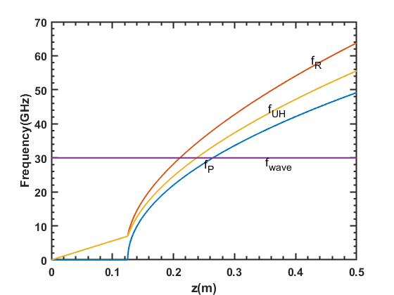



Numerical Test
$$B_{0}$$
X mode Cutoff Test(B DIRECTION)
Source frequency :30GHz
$$z$$
$$E_{x}$$
Cutoff layer
ne ,B distribution
Characteristic frequency

Slide 11
Simulation Results
The EMW is blocked at the cutoff layer

Slide 12
Application:
USPR simulation
Density and Magnetic distribution
Plasma frequency distribution
Launch a pulse from here
Plasma region

Slide 13
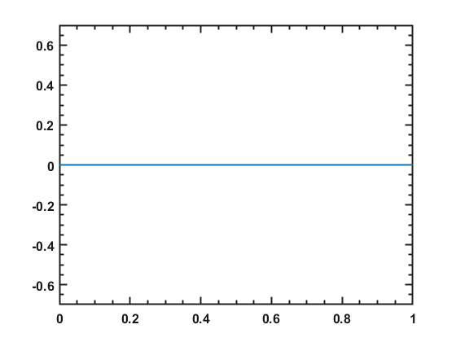
Movie show:
USPR signal propagation in the plasma
Ex
z/m

Slide 14
Launch Wave
Receive Wave

Slide 15
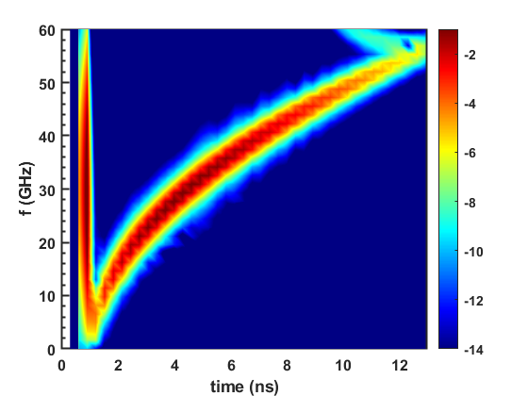
Sample Point Signal
Short time Fourier analysis of Sample Point signal

Slide 16
CODE BENCHMARK

Slide 17
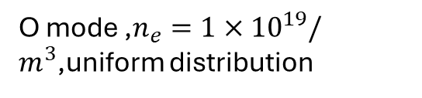

$$B_{0}$$
$$z$$
$$z$$
$$E_{x}$$
$$E_{x}$$
O mode ,$n_{e}={1×10}^{19}/m^{3}$,uniform distribution
X mode ,$n_{e}={1×10}^{19}/m^{3}$,B=1T,
Uniform distribution

Slide 18
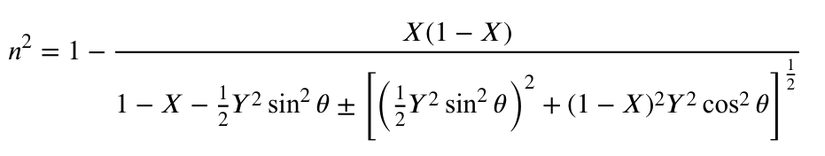




B₀=1T,ne₀=1e19/m3,uniform distribution
$$B_{0}$$
$$θ=\frac{π}{4}$$
$$z$$
$$E_{x}$$
n₊(theory)=0.432
n₊(numerical)=0.429
n₋(theory)=1.128
n₋(numerical)=1.129

Slide 19
Next plans to do:
Analyze the mode conversion in the BEST tokamak: What is the polarization of the reflected wave when the X-mode is launched perpendicularly into the plasma?
Add density perturbation and plasma current to the J to include more detailed physical process.
Analyze the mode conversion of a laser in NSTX-U from the High-k scattering system.
Analyze the density measurement error caused by mode conversion in the FIRTIP system.

Slide 20
$\frac{∂J}{∂t}=ω_{ce}×J+ε_{o}ω_{pe}^{2}E−νJ=\left(ω_{ce0}+ω_{ceB}\right)×J+ε_{o}ω_{pe}^{2}E$ $−νJ$
Case application
1. Give more example about the 1d fdtd with Magnetic angle ;
2. CTS mode conversion simulation on the midplane with 105GHz frequency on BEST Tokamak ;
3.

